Slide 1
2023 Mid-Atlantic Spring Conference March 31, 2023
CHESAPEAKE BAY MAGAZINE MARKETING CAMPAIGN

Slide 2
AGENDA
What is it?
Who is responsible?
What does it look like?
How does it work?
What is my role?
How do we measure success?
Notes:
Stephanie – review agenda

Slide 3
WHAT IS IT?
A joint venture between the Henry E. Sweet Trust, Chesapeake Bay Media and ABC Mid-Atlantic, using the Learn Engage Connect theme developed by the national organization.
The Chesapeake Bay Magazine was chosen as it provides the most coverage for our district.
The goal is to provide information to boaters to encourage both safer boating and interest in America’s Boating Club.
Notes:
Stephanie - The Chesapeake Bay Magazine releases 6 hard copy issues annually and twice a week digital issues. The digital released are viewed by approximately 27,000 readers.

Slide 4
Who is Responsible?
EVERYONE!!
While there is a team comprised of past and present Bridge Officers, along with supporting marketing and IT individuals, if all of our squadrons participate the program has a much greater chance to be successful.
Notes:
Stephanie - There is a team at D/5 who will monitor the activity on the page including how many “clicks” it receives, where the individual is located and whether the local Squadron has contacted any interested individual.
The team is comprised of the DEO, AO, AAO, AEO and D/C.

Slide 5
WHAT DOES IT LOOK LIKE?
Regularly changing media in both the hard copy magazine and digital releases provide a link to a special website that has links to a variety of resources.
Notes:
Marty

Slide 6
WHAT DOES IT LOOK LIKE?
Notes:
Marty – this is the ad as it appears in the hard copy and digital releases. On the digital version a person can click on the link and it will take them directly to a landing page.

Slide 7
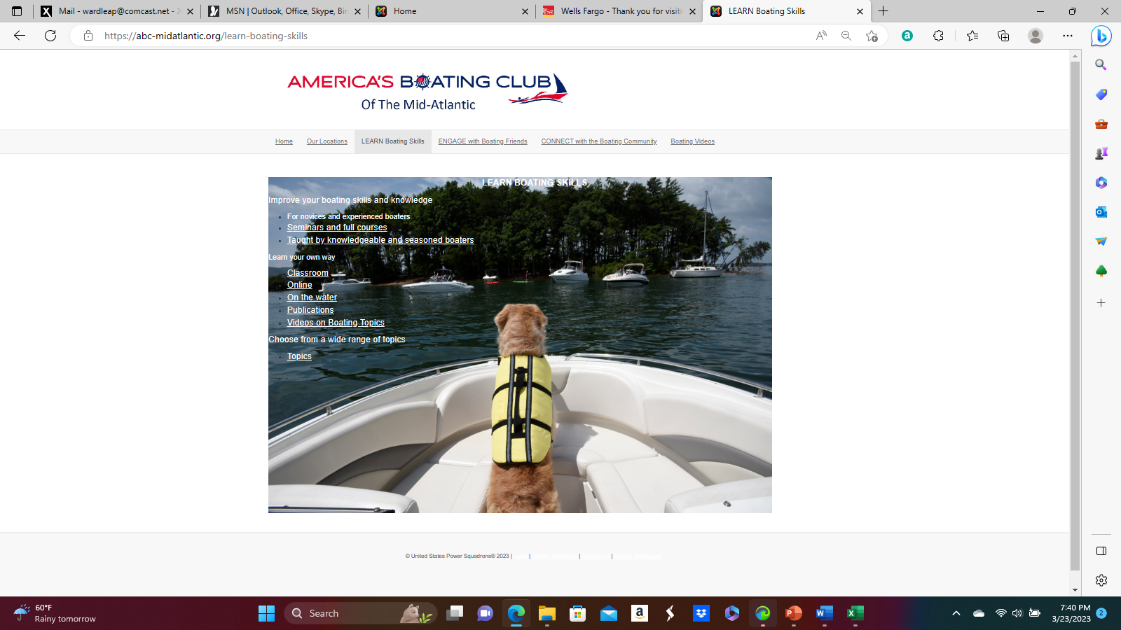
HOW DOES IT WORK?
Notes:
Marty - This is what the landing page looks like. There are tabs on the top and each tab will bring up a list of available topics that a person can learn about. There is also a fillable form where someone can give us their contact information. In that event, the District team will send you the information.

Slide 8
WHAT DOES IT LOOK LIKE? When an interested person clicks on a topic in the top bar it will take them to the specific page. Each page will have a variety of resources connected to that topic.
Notes:
Marty – there are several boxes on the top that a person can click into, including Our Locations, Learn Boating Skills, Engage with Boating Friends, Connect with the Boating Community, and Boating Videos.

Slide 9
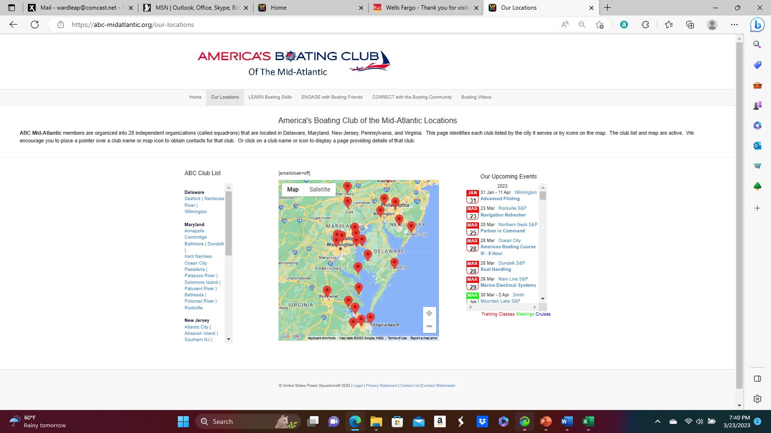
HOW DOES IT WORK?
Notes:
Marty - A viewer is able to see where all of our District Squadrons are located and can click on each to take them directly to the specific website for that Squadron.

Slide 10
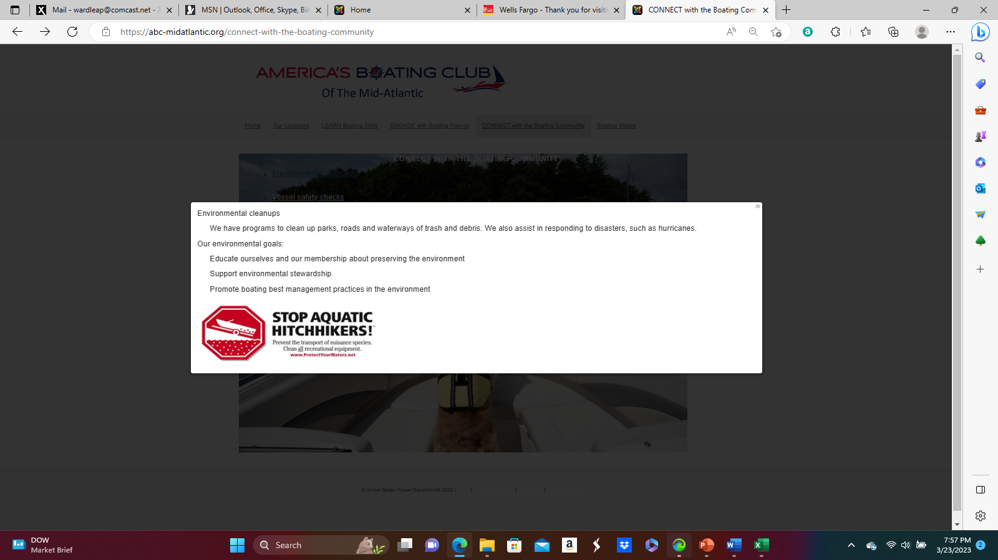
HOW DOES IT WORK?
Notes:
Marty - This is an example of the type of information that would pop up when someone clicks on Environmental Clean Ups under the Engage with the Boating Community tab.

Slide 11
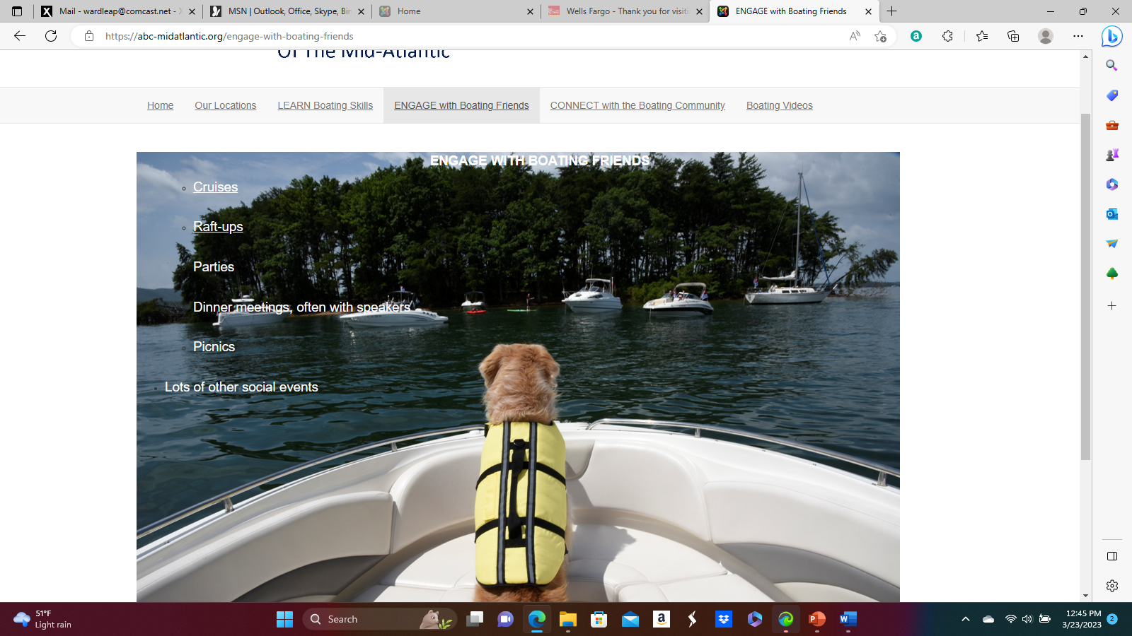
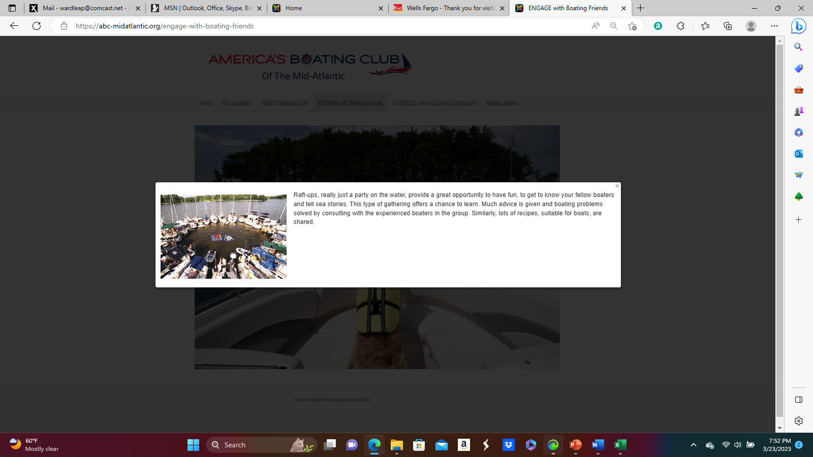
Notes:
Marty - This is what someone would see if they click on Raft Ups under the Engage with Boating Friends tab.

Slide 12
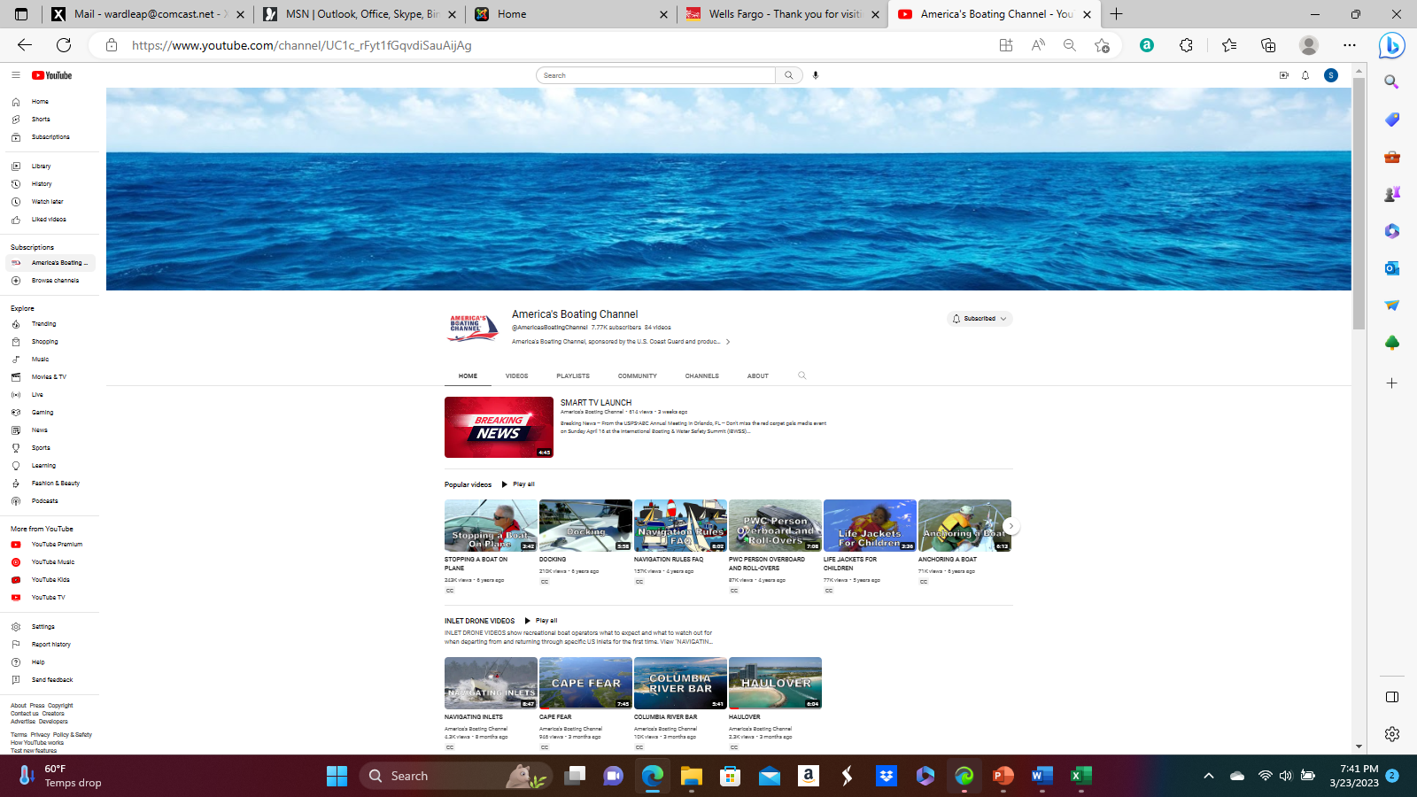
HOW DOES IT WORK?
Notes:
Marty - The last tab titled Boating Videos take them to the America’s Boating Channel site and includes all of the published videos. This is the only “click” where someone would actually leave the landing page.

Slide 13
WHAT IS MY ROLE?
Promotion!
Use the media provided on your Facebook pages, Twitter accounts and any other social media that you use.
Utilize local newspapers, magazines, radio and TV stations, and online community bulletin boards.
Add verbiage to explain:
America’s Boating Club Kent Narrows members come together to LEARN boating skills, ENGAGE with boating friends, and CONNECT with the boating community…
Promote again! And Again! And Again!
Notes:
John – there are 2 ways to take advantage of this valuable resource. First – use what if being provided in your local areas. Several of our Squadrons have added local contact information so someone can immediately reach out to them for additional information. Marketing research has shown that on average, it takes a message 7 times to get traction. So if you don’t get immediate results, keep trying!
Secondly, It’s critical that if you are given a contact from the site that you reach out immediately. The District team will be following up to ensure that this is done.

Slide 14
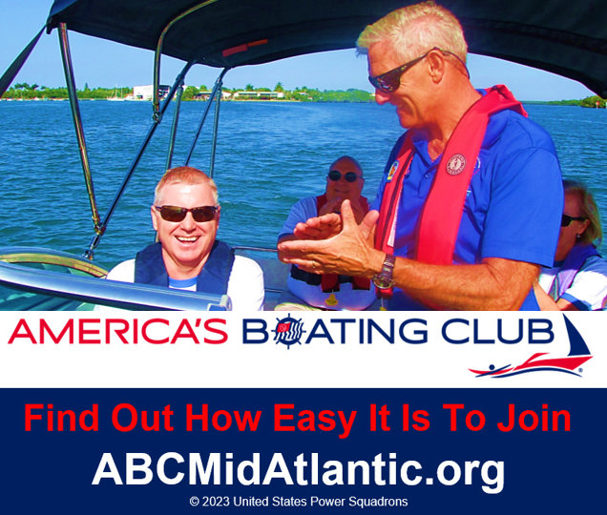
WHAT IS MY ROLE?
Notes:
John – the media changes on a regular basis so as not to get stale. You will be provided with the media each time a change is made so you can update your local efforts.

Slide 15
WHAT IS MY ROLE?
A BEST KEPT SECRET NO MORE
Although not known to many, as a nationwide organization of boating enthusiasts, America’s Boating Club has a strong presence in the Mid-Atlantic region with thirty local clubs in Delaware, Maryland, New Jersey, Pennsylvania, Virginia, and Washington, DC.
America’s Boating Club members come together to learn boating skills, engage with boating friends, and connect with the boating community.
America’s Boating Club represents one of the most attractively priced ways to gain valuable boater education with courses, seminars, and training offered online, in classrooms, and on-the-water.
Members engage in boating activities like raft-ups, cruises, parties with expert boating speakers, and going to boat shows.
Whether your idea of boating is yachting, speedboating, fishing, jet-skiing, sailing, paddling, or engaging in water sports like waterskiing, wakeboarding, or tubing, you’ll find boaters like you in America’s Boating Club.
To learn more about a club near you and how easy it is to join, visit ABCMidAtlantic.org.
Notes:
John – we have also distributed some sample verbiage that you can use. This was written by marketing experts and should be helpful in your efforts.

Slide 16
WHAT IS MY ROLE?
LEARN – ENGAGE – CONNECT
America’s Boating Club is a nationwide organization of boating enthusiasts with a strong
presence in the Chesapeake Bay region. America’s Boating Club Mid-Atlantic has thirty local clubs in Delaware, Maryland, New Jersey, Pennsylvania, Virginia, and Washington, DC.
America’s Boating Club members come together to learn boating skills, engage with boating friends, and connect with the boating community.
America’s Boating Club represents one of the most attractively priced ways to gain valuable boater education with courses, seminars, and training offered online, in classrooms, and on-the-water.
Members engage in boating activities like raft-ups, cruises, parties with expert boating speakers, and going to boat shows.
Whether your idea of boating is yachting, speedboating, fishing, jet-skiing, sailing, paddling, or engaging in water sports like waterskiing, wakeboarding, or tubing, you’ll find boaters like you in America’s Boating Club.
To learn more about a club near you and how easy it is to join, visit ABCMidAtlantic.org.

Slide 17
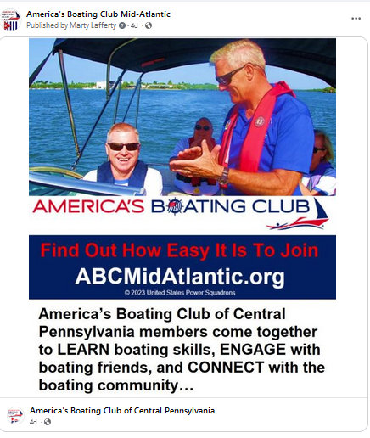
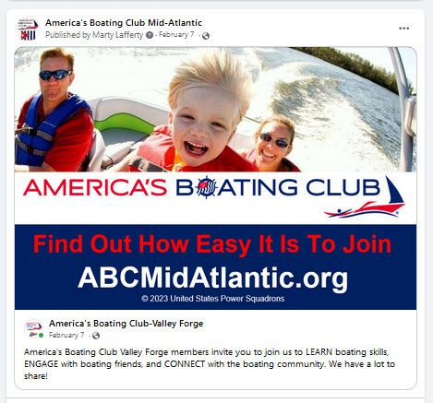
WHAT IS MY ROLE?

Slide 18
WHAT IS MY ROLE?
Outreach is critical!
There is a form on the website that people can complete that asks for personal contact.
We MUST do timely outreach to capitalize on their interest.
Notes:
John – we can’t stress enough the importance of timely follow up. If a person has to wait too long for outreach they may forget all about ABC and lose interest.

Slide 19
HOW DO WE MEASURE SUCCESS?
How many “clicks” do we get?
As of 3/11 we had 1059 clicks!
How many people ask to be contacted?
How many of these can we convert to members?
How many courses and seminars are requested/conducted as a result of this campaign.
How is traffic on local media impacted?
Notes:
Joe – As you can see, the traffic on the site has been impressive and continues to increase. While some of the initial hits may have been our team and your members checking out the site, the traffic has increased each month. We want to be able to measure our success based on how many hits we get, how many people ask to be contacted and how many people can we convert to members.
In addition, we understand from some of the Commanders that their local media such as Facebook, has experienced increased traffic since the campaign started.

Slide 20
REMEMBER!!
Promote, promote, promote
Monitor requests that are forwarded to your Squadron/Club
Quickly respond and follow up with the interested party
Notes:
Stephanie

Slide 21
THANK YOU FOR YOUR ATTENTION!
QUESTIONS??

